Slide 1
Control Statements in Python

Slide 2
Control Statements
Control statements determine the flow of execution of a program. They help us make decisions, repeat tasks, or change the normal sequence of execution.

Slide 3
Types of Control Statements
There are three main types:
Selection (Decision-Making) Statements
Iteration (Looping) Statements
Jump (Transfer) Statements

Slide 4
1. Selection Statements
These statements execute different blocks of code based on a condition.
Types
If
if...else
if...elif...else
Nested if

Slide 5
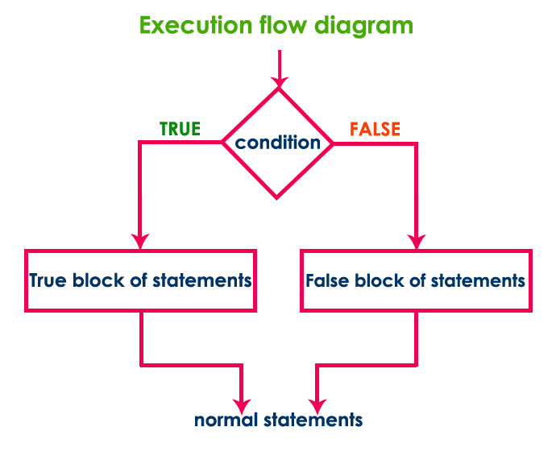
Flow of a Selection Statement

Slide 6
1. if Statement
Used when you want to execute code only if the condition is True.
Syntax:
if condition:
statements

Slide 7
2. if...else Statement
Used when there are two possible outcomes.
if condition:
statements
else:
statements

Slide 8
3. if...elif...else Statement
Used when there are multiple conditions.
if condition1:
statements
elif condition2:
statements
elif condition3:
statements
else:
statements

Slide 9
4. Nested if
An if statement inside another if statement.
Syntax
if condition1:
if condition2:
statements

Slide 10
5. Short-hand if
Used when there is only one statement.
age = 20
if age >= 18: print("Adult")

Slide 11
6. Short-hand if...else (Ternary Operator)
Syntax:
value_if_true if condition else value_if_false
Example:
num = int(input("Enter a number: "))
print("Positive") if num > 0 else print("Negative or Zero")

Slide 12
Loop Statements
A loop statement is used to execute a block of code repeatedly without writing the same code multiple times.
Types of Loop Statements in Python
Python provides two loop statements:
for Loop
while Loop

Slide 13
1. for Loop
A for loop is used when the number of iterations is known in advance.
Syntax
for variable in sequence:
statements

Slide 14
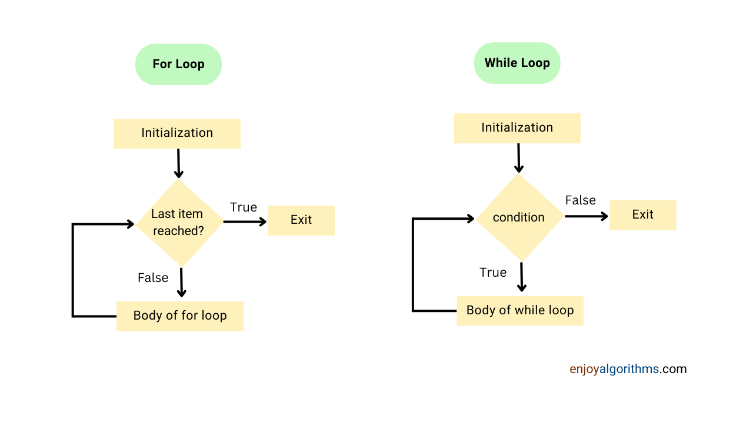

Slide 15
2. while Loop
A while loop is used when the number of iterations is not known in advance. It continues executing as long as the condition is True.
Syntax:
while condition:
statements

Slide 16
range()
The range() function generates a sequence of numbers.
range(stop)
range(start, stop)
range(start, stop, step)

Slide 17
Difference Between for and while
for Loop | while Loop
Used when the number of iterations is known | Used when the number of iterations is unknown
Iterates over a sequence | Executes while a condition is true
Easier for fixed repetitions | Better for condition-based repetition
Example: Print 1–10 | Example: Login until correct password

Slide 18
Nested Loops
A loop inside another loop is called a nested loop.
The outer loop controls how many times the inner loop executes.
For each iteration of the outer loop, the inner loop runs completely.

Slide 19
Types of Nested Loops
Nested for loop
Nested while loop
for inside while
while inside for

Slide 20
1. Nested for Loop
Syntax:
for outer in sequence:
for inner in sequence:
statements

Slide 21
2. Nested while Loop
while condition1:
while condition2:
statements

Slide 22
Jump Statements
jump statements are used to change the normal flow of execution in a program.
They are mainly used inside loops (for, while) to:Exit a loop.
Skip an iteration.
Leave a block empty for future implementation.

Slide 23
Types of Jump Statements
Break
Continue
pass

Slide 24
1. break Statement
he break statement immediately terminates the loop and transfers control to the statement after the loop.
Syntax:
for variable in sequence:
if condition:
break

Slide 25
continue Statement
The continue statement skips the current iteration and continues with the next iteration of the loop.
Syntax:
for variable in sequence:
if condition:
continue
statements

Slide 26
pass Statement
The pass statement does nothing. It is used as a placeholder where code will be written later.
Syntax:
if condition:
pass

Slide 27
Problem Statements
Problem Statement-1
An ATM should allow a customer to withdraw money only if their account balance is greater than or equal to the requested amount.
Problem Statement-2
A college wants to assign grades based on students' marks.
90–100 → A+
75–89 → A
60–74 → B
35–59 → C
Below 35 → Fail

Slide 28
Problem Statement
Problem Statement
Write a Python program that allows a user to enter the password. The user gets a maximum of 3 attempts. If the correct password is entered, display "Login Successful"; otherwise, display "Account Locked".
Problem Statement
Write a Python program to print numbers from 1 to 50, but skip numbers that are multiples of 5.

Slide 29
Problem Statement
Problem Statement
A robot can climb either 1 stair or 2 stairs at a time.
Write a Python program to determine the number of different ways the robot can reach the nth stair.
Sample output:
Enter Number of Stairs: 5
Number of Ways = 8

Slide 30
Problem Statement
Problem Statement
An investor decides to invest money every month according to the Fibonacci sequence.
Month 1 → ₹1000
Month 2 → ₹1000
Month 3 → ₹2000
Month 4 → ₹3000
Month 5 → ₹5000
...

Slide 31
Continue..
Write a Python program to:
Read the number of months.
Display the monthly investment.
Calculate the total investment.
Display the highest monthly investment.

Slide 32
Problem Statement:
Write a program to print only the even numbers from 1 to 20. Skip all odd numbers using continue.
Expected Output
2
4
6
8
10
12
14
16
18
20

Slide 33
Problem Statement
Given a string, find the first vowel and stop searching.
Sample Input
Rhythmapple
Expected Output:
First vowel: a

Slide 34
Problem Statement
Write a program to print numbers from 1 to 100 with the following conditions:
Skip numbers divisible by 5.
Stop the loop completely if the number reaches 75.
Expected Output

Slide 35
1
2
3
4
6
7
...
74

Slide 36
Print only alphabets from a given string.
Bus Seat Booking
Seat numbers:1 2 Reserved 3 4
Full 5Rules:Skip reserved seats.
Stop booking when "Full" appears.

Slide 37
Fibonacci series
The Fibonacci series is a sequence of numbers where each number is the sum of the previous two numbers.
The sequence starts with:
0, 1, 1, 2, 3, 5, 8, 13, 21, 34, ...

